Slide 1

India Agentic AI Open Hackathon
TEAM NAME
< CHOSEN TRACK >

Slide 2
Contents:
Team introduction
AI Use-case
Tech Stack
Roadmap
Instructions:
Teams can use more than one slide per section.
Teams should restrict the total number of slides to a maximum of 15.
Teams can add optional points which they believe would support their application.
Please submit the presentations prior to the application deadline.
Keep it simple and to the point for the reviewers to make judgement.

Slide 3
TEAM INTRODUCTION
SKILLSET / EXPERIENCE

Slide 4
Skillset / Experience
Please provide details of your organisation.
Explain about the team’s skill set with respect to Agentic AI Tools/Frameworks.
Explain about your team’s current AI deployment setup.(Ex: NIMs, OpenAI API etc.)
Have you worked with any NVIDIA agentic and model training libraries? (eg: NeMo, MegtronBridge, Nemo Agent Toolkit etc)
Optional - Kindly provide your past experiences (if any) of participating in AI Hackathons.

Slide 5
AI Use Case
Expand on your project

Slide 6
AI Use Case: Expand on your Project
TRACK | A/B/C
(Details of Project: Be as descriptive as you want to be.)
Project Title - Please mention title name as submitted in the form.
Project Description
Project Motivation - Kindly explain if you are currently working on this or a similar project in your organisation and why it matters to you.
Dataset for training and inferencing
Explain details of existing /planned dataset.
Specify the scale (eg. number of documents, size in GB, number of tokens)
Clearly mention the license of all datasets you plan to use.
Results achieved - Optional
Provide the details of your experiments and accuracy so far.
Notes:
Teams are recommended to be as much descriptive as possible and highlight the methodology clearly.
Teams are recommended to expand on this topic and use as many slides as you prefer.

Slide 7
Tech Stack
Strategy for building/improving your project

Slide 8
Points to be covered in slide
Prior experience in Generative and Agentic AI Tools, Libraries and Frameworks.
Which tools and/or AI frameworks are currently / planned to be used ?
Any similar work you encountered and took motivation from the literature?
Kindly list the NVIDIA SDKs and Tools you plan to use to solve the problem.
Will you perform model training (fine tuning)?
Yes
No (Inference Only)
What steps need to be/ are done differently to develop and deploy your solution.
Explain the potential bottlenecks of your proposed/ current solution.

Slide 9
Road Map
Ideas for further improvement of the solution.

Slide 10
Please specify the areas where you would like to seek mentor support.
Provide the long term goals for improvement of your project.
Address the key limitations of your project.
Explain your ideas to overcome and improve on the limitations.
Notes:
Teams are recommended to be as much descriptive as possible.
Teams are recommended to expand on this topic and use as many slides as you prefer.

Slide 11
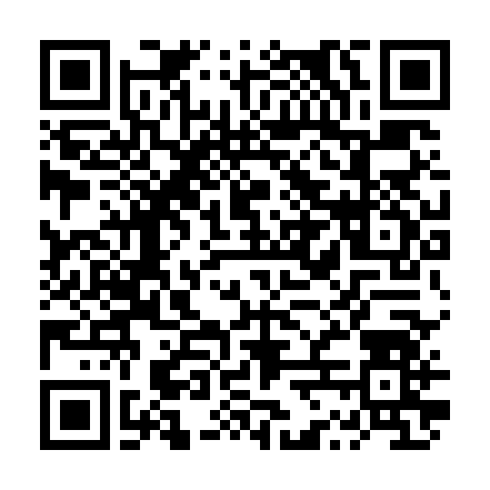
Need Help? Contact Us!!
Join the Slack Workspace here

